Slide 1




DEPARTMENT OF COMPUTER SCIENCE AND ENGINEERING
PREDICTIVE POWER MACHINE LEARNING MODELS FOR MACHINE FAILURE STATUS
TEAM MEMBERS
GUIDE :
MRS.S.SOPHANA JENNIFER ., M.E
ASSISTANT PROFESSOR
ABINAYA S [211421104005]
ABINISHEKA S S [211421104006]
COORDINATOR :
DARSHINI A[211421104048]
DR.S.KAVITHA SUBRAMANI.,M.E.,PH D.,

Slide 2




ABSTRACT
In industries, predicting machine failures in advance is crucial to reducing downtime and improving efficiency.
This project focuses on building machine learning models to predict when industrial machines might fail.
The process includes cleaning and preparing the data to ensure accuracy, visualizing the data to identify useful patterns, and implementing suitable machine learning models.
The final predictive models are integrated with a Django-based web interface, making it easy for users to monitor machine conditions and get failure predictions.
This system helps in making timely maintenance decisions, improving reliability and efficiency.

Slide 3
INTRODUCTION
Traditional maintenance methods rely on scheduled inspections or reactive repairs after a failure occurs, which can be costly and inefficient.
This project introduces a predictive maintenance system that leverages machine learning to anticipate machine failures before they happen. By analyzing data from industrial machines, our system identifies patterns and predicts potential breakdowns. The workflow includes data preprocessing to clean and prepare data, visualization to uncover useful insights, and model implementation to generate accurate failure predictions.
To make this technology accessible, we have integrated the predictive models into a Django-based web application, allowing users to monitor machine health and receive alerts for proactive maintenance. This approach not only reduces downtime and repair costs but also enhances overall operational efficiency.

Slide 4
OBJECTIVES
PREDICT TYPES OF MACHINE FAILURE
PATTERN IDENTIFICATION
BETTER ACCURACY
IMPROVING INDUSTRIAL PRODUCTIVITY
ENHANCE MAINTENANCE

Slide 5
LITERATURE SURVEY
TITLE | AUTHOR | YEAR | METHODOLOGY
Machine Failure Prediction Using Machine Learning | Varshini Manda, Dr. K. Neeraja | 2021 | This paper follows a step-by-step approach to study how machine learning (ML) techniques are used for predicting machine failures in industries. First, it conducts a literature review of past research, analyzing studies from the late 1980s to the present to understand the evolution of AI/ML in predictive maintenance. The paper also examines how ML is applied in different industries like hardware and software and evaluates which techniques are most effective. Through this analysis, LSTM (Long Short-Term Memory) is found to be one of the most commonly used and effective methods for predicting machine failures.

Slide 6
LITERATURE SURVEY
TITLE | AUTHOR | YEAR | METHODOLOGY
Predictive Maintenance using machine learning on water pump | Dr. Sharda Chhabria, Rahul Ghata, Varun Mehta, Ayushi Ghosekar, Manasi Araspur, Nandita Pakhide | 2022 | This study focuses on predicting water pump failures using machine learning (ML) and IoT (Internet of Things) technologies. The process begins with collecting real-time data from water pumps, including statistics, recorded events, and past failures. This data is then processed and analyzed to identify patterns that indicate potential breakdowns. Next, a machine learning model using the Random Forest algorithm is implemented to predict failures before they occur. The system is also integrated with IoT devices, which allow for real-time monitoring and data collection, making it easier to track machine health.This approach enables industries to take preventive actions before a pump breaks down, improving efficiency and reducing maintenance costs.

Slide 7
LITERATURE SURVEY
TITLE | AUTHOR | YEAR | METHODOLOGY
Using Machine Learning and Deep Learning Algorithms for Downtime Minimizationin the Manufacturing Systems: An Early Failure Detection Diagnostic Service | Mohammad Shahin | 2023 | This study explores how machine learning (ML), deep learning (DL), and deep hybrid learning (DHL) can help detect failures early and reduce downtime in manufacturing systems.The study tests over 20 different fault detection models, using various ML and DL techniques. The performance of these models is then evaluated using accuracy, precision, recall, and F-score to determine which ones work best. The results show that Deep Forest and Gradient Boosting algorithms performed the best, with over 90% accuracy, while Multinomial Logistic Regression and Long Short-Term Memory (LSTM) models also provided good results with above 80% accuracy.

Slide 8
LITERATURE SURVEY
TITLE | AUTHOR | YEAR | METHODOLOGY
Machine Predictive Maintenance Using machine Learning | Logith Vikram K1 , Lohit T2 , Duvarakesh R | 2024 | This project uses machine learning (ML) to predict machine failures and improve industrial maintenance efficiency. A machine learning model is developed to predict when a machine might need maintenance. Once implemented, the system continuously monitors machine conditions in real time and provides alerts before a failure occurs, allowing timely maintenance actions. The project also compares different maintenance approaches, including reactive maintenance (fixing machines after failure), preventive maintenance (regular check-ups), and predictive maintenance (using ML to prevent failures before they happen). By integrating ML with real-time monitoring, this system helps industries reduce downtime, lower maintenance costs, and improve overall operational efficiency.

Slide 9



EXISTING SYSTEM
In many industries, AI models are used for making important decisions, like predicting machine failures or detecting issues in critical systems. However, these models sometimes make mistakes but still act very confident in their wrong predictions.
There are two main types of incorrect predictions:
Misclassified Samples – The model predicts incorrectly but still gives a high confidence score.
Example: A machine that is actually failing is predicted as "Normal" with high confidence.
Out-of-Distribution (OOD) Samples – The model sees completely new data (never seen before) and misclassifies it with high confidence.
Example: A model trained on one type of machine tries to predict failures for a different type of machine and fails.

Slide 10
EXISTING SYSTEM
Solution: Flat Minima
To fix this, researchers introduced a new method called Flat Minima, which helps the model clearly separate correct predictions from incorrect ones. This method improves failure prediction across different conditions:
-> balanced [Known data]
-> long-tailed [Limited data]
-> covariate-shift classification scenarios [Pattern change]
Focus on
--Wrong predictions
--No practical implementation
--Improving the model accuracy

Slide 11





PROPOSED SYSTEM
PREDICTS TYPE OF FAILURE
PROVIDES PREVENTIVE MEASURES AND MAINTENANCE
🔹The system not only detects whether a failure will occur but also identifies the type of failure (e.g., mechanical, electrical, or operational).
🔹 Helps industries take specific preventive actions based on the failure type.
🔹 Instead of reacting after a failure, the system suggests preventive actions to avoid breakdowns.
🔹 Helps in scheduling maintenance at the right time, reducing repair costs and downtime.
HIGH ACCURACY ALGORITHM
USER-FRIENDLY INTERFACE
🔹 Uses advanced machine learning models to ensure accurate predictions.
🔹Improves over existing methods by handling imbalanced, changing, and complex data more
🔹 A Django-based web application makes the system easy to use for engineers and operators.
🔹 Provides real-time failure predictions, visual insights, and interactive monitoring, improving practical usability compared to traditional models.

Slide 12
TYPES OF FAILURES
HEAT DISSIPATION FAILURE
OVERSTRAIN FAILURE
POWER FAILURE
RANDOM FAILURE
TOOL WEAR FAILURE

Slide 13
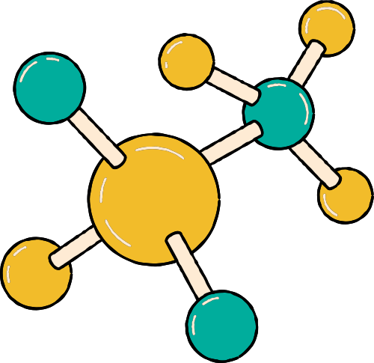
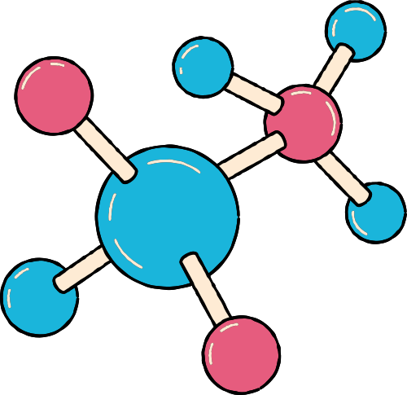
SOFTWARE AND HARDWARE USED
SOFTWARE REQUIREMENTS:
HARDWARE REQUIREMENTS:
Operating System: Windows 10 or later
Visual Studio Code – Used for writing and running the code efficiently
Anaconda with Jupyter Notebook – For data preprocessing and model development
Django Framework – For backend development and web application integration
Libraries: NumPy, Pandas, Scikit-Learn, Matplotlib etc.
Processor: Intel i3 or higher
Hard Disk: Minimum 80 GB
RAM: At least 2 GB

Slide 14
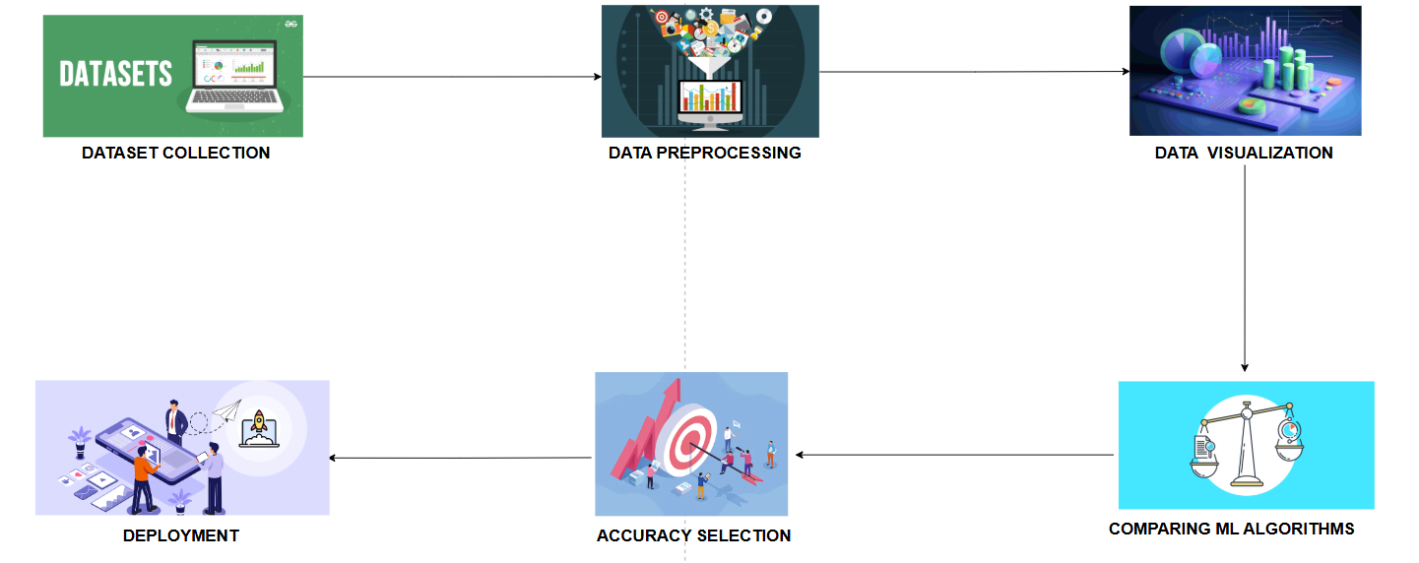
SYSTEM ARCHITECTURE

Slide 15
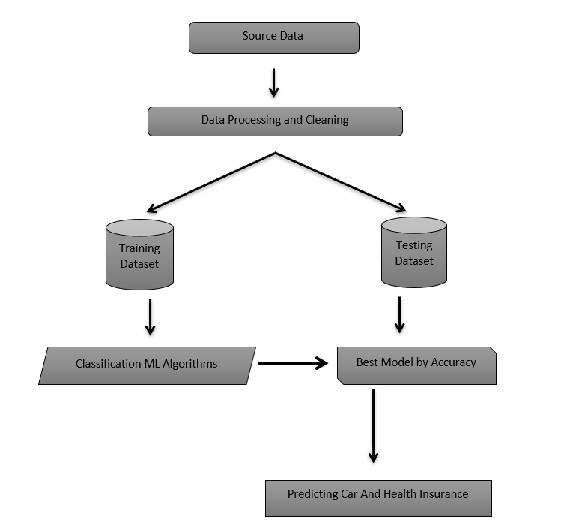
WORKFLOW

Slide 16
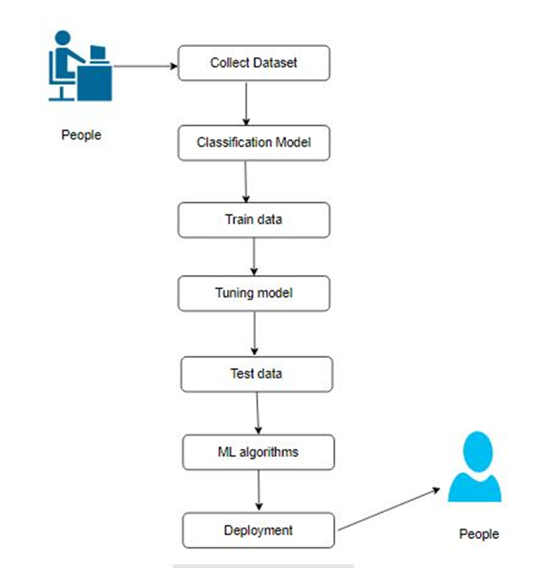
USE CASE DIAGRAM

Slide 17
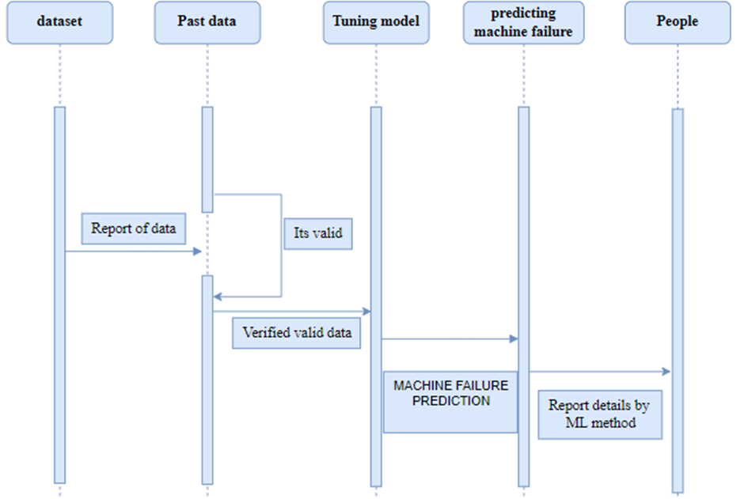
SEQUENCE DIAGRAM

Slide 18
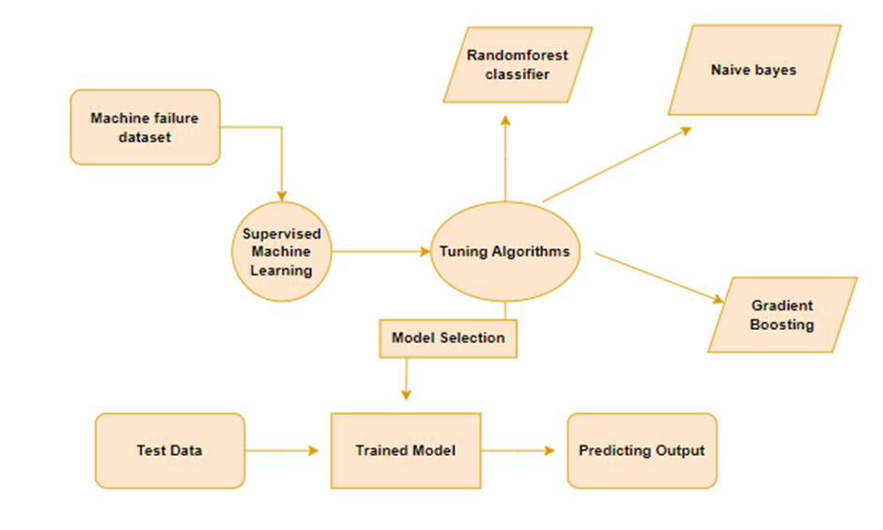
ENTITY RELATIONSHIP DIAGRAM

Slide 19
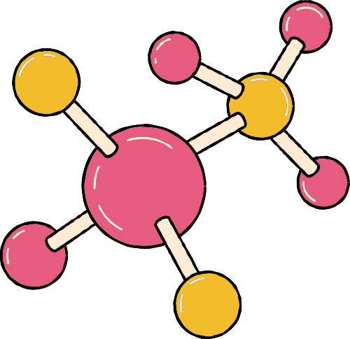
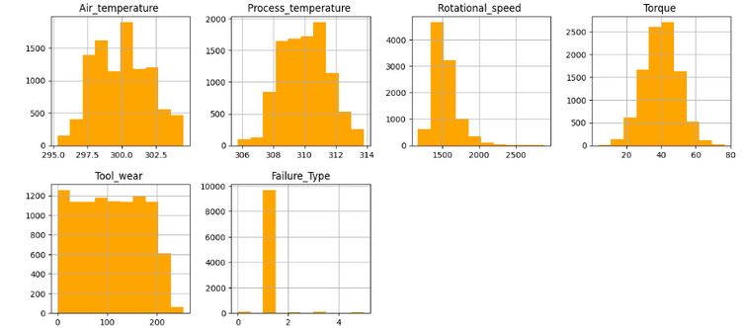

MODULE DESCRIPTION
DATA PREPROCESSING MODULE
DATA VISUALIZATION MODULE
Cleans and normalizes raw machine data.
Handles missing values and outliers for accurate predictions.
Uses graphs and charts to analyze machine performance trends.
Selects the most critical features affecting machine failure.

Slide 20


MODULE DESCRIPTION
MACHINE LEARNING MODEL MODULE:
USER INTERFACE &WEB INTEGRATION MODULE
Implements algorithms like Random Forest, Gradient Boosting, etc.
Trains the model to predict different types of machine failures.
Built using Django Framework and Visual Studio Code for deployment.
Provides a web-based platform for users to input machine data and get failure predictions

Slide 21

ALGORITHMS
1. RANDOM FOREST CLASSIFIER
2. NAIVE BAYES CLASSIFIER
Works by creating multiple decision trees and combining their results to make a final prediction.
ACCURACY- 99.93%
Uses probabilities to make predictions.
Assumes that each feature works independently, which may not always be true.
ACCURACY-39.19%
3.GRADIENT BOOSTING ALGORITHM
Learns step by step, correcting its mistakes in each round.
Think of it like improving at a game by learning from previous errors.
ACCURACY-98.85%

Slide 22
RESULTS
The results of our predictive power machine learning model for machine failure status indicate that the Random Forest Classifier achieved the highest accuracy of 99.93%, making it the most reliable algorithm for failure prediction.
Naive Bayes Classifier performed poorly with an accuracy of only 39.19%, due to its assumption that all input features are independent, which is not ideal for machine failure prediction.
These findings highlight that Random Forest Classifier and Gradient Boosting Algorithm are the most suitable algorithms for predictive maintenance, providing a highly accurate and reliable approach to detecting failures in advance.
The low performance of Naive Bayes Classifier confirms that simpler probabilistic models are not effective for this type of complex problem.

Slide 23
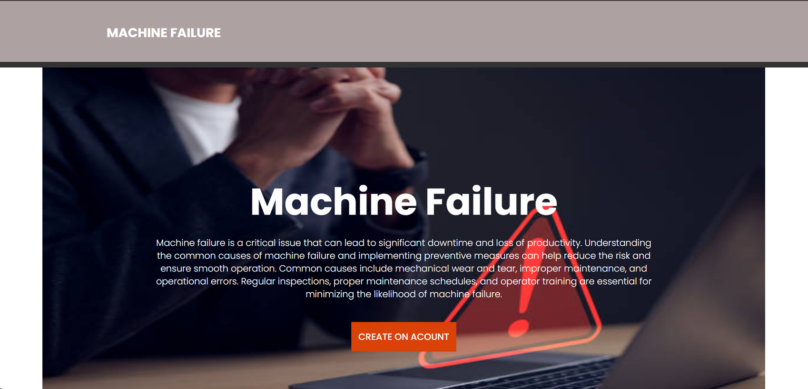
SCREENSHOTS
1.ACCOUNT CREATION PAGE

Slide 24
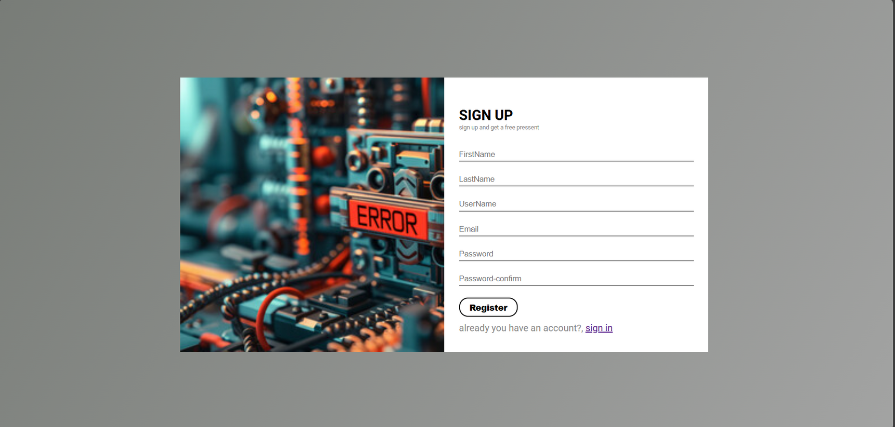
2.SIGNUP PAGE

Slide 25

3.SIGNIN PAGE

Slide 26
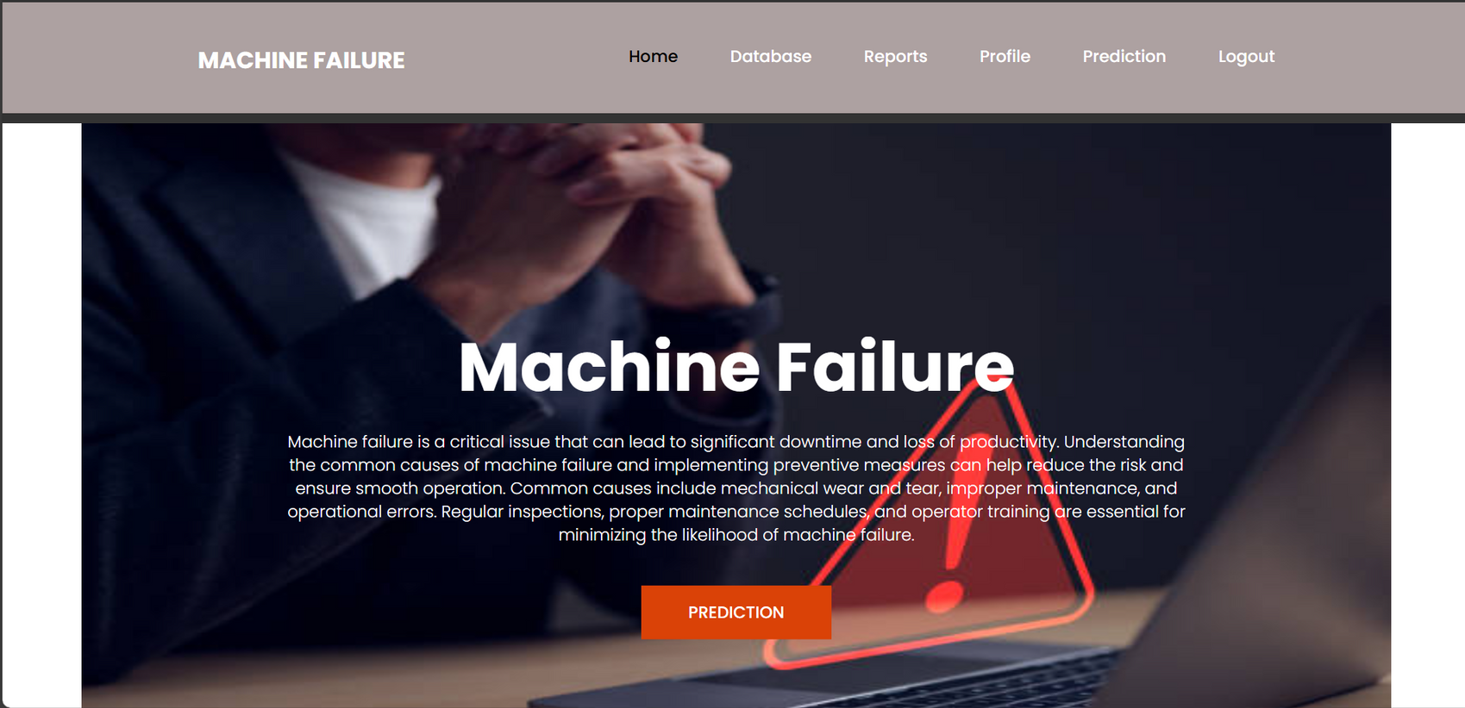
4.HOME PAGE

Slide 27
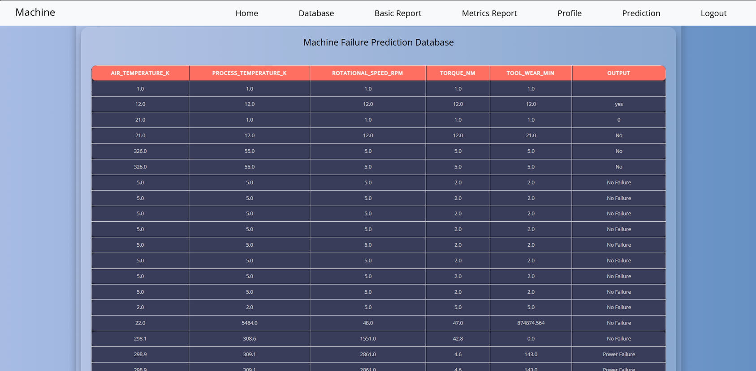
5.DATABASE PAGE

Slide 28
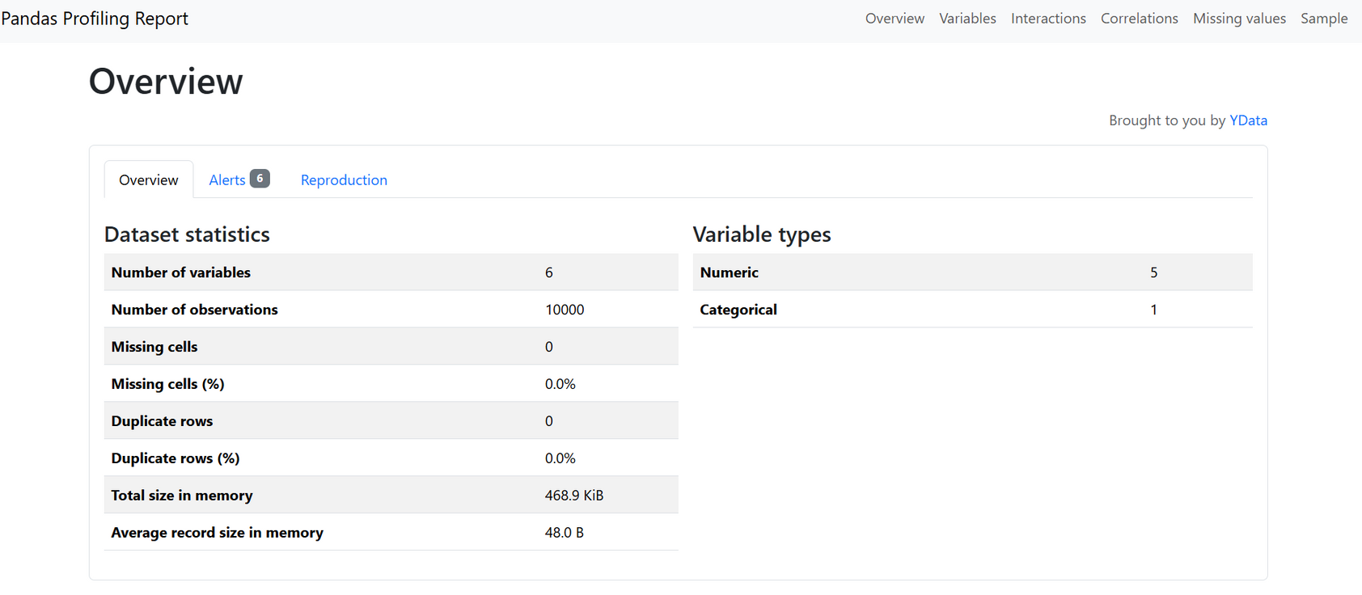
6.REPORT PAGE

Slide 29
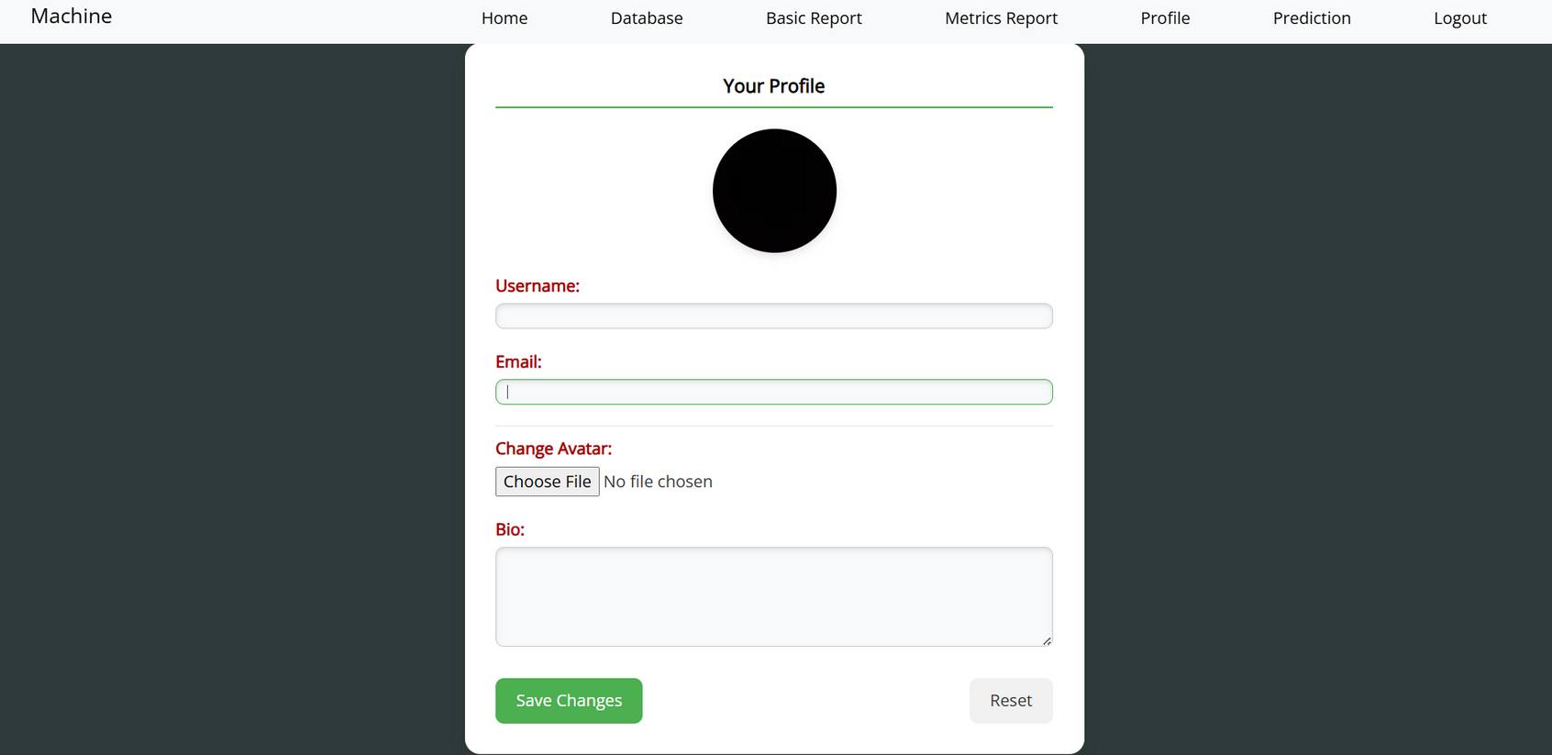
7.PROFILE PAGE

Slide 30
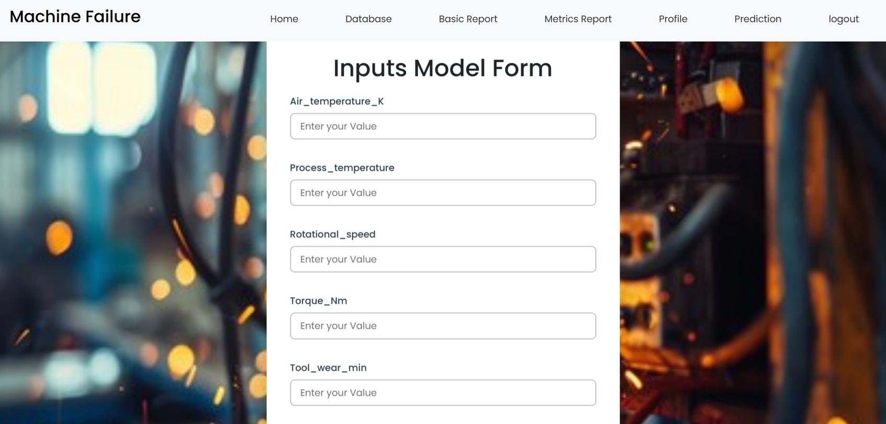
8.PREDICTION PAGE

Slide 31
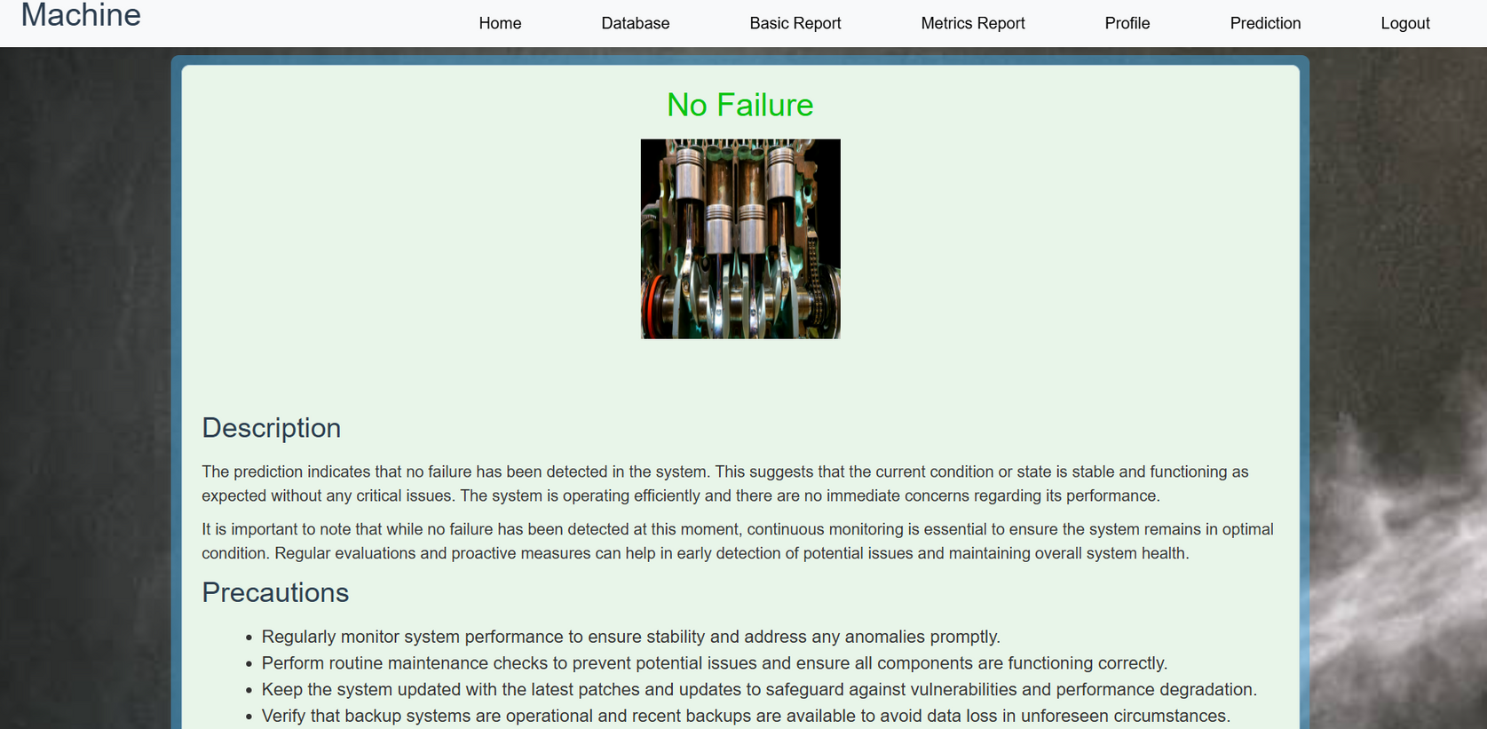
9.RESULT PAGE

Slide 32
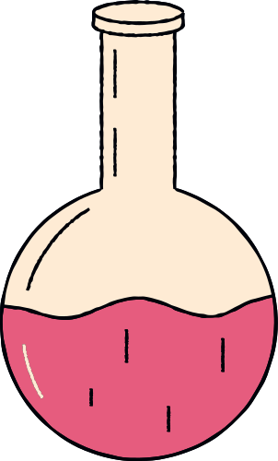
FUTURE ENHANCEMENTS
Future enhancements include integrating real-time data using IoT sensors for instant failure detection and proactive maintenance.
The model can be customized for different industries, ensuring more precise predictions.
A cloud-based implementation would allow remote access and seamless data updates. Additionally, an AI-driven recommendation system could automate maintenance schedules.
Implementing self-learning mechanisms will help the model adapt over time, improving accuracy.
Finally, a mobile-friendly interface can enable users to monitor machine status and receive alerts on the go, making predictive maintenance more efficient and scalable.

